Slide 1

Income Tax Calculation System for a Salaried Person
INT-213
Submitted to : Gagandeep Kaur
UID : 23625
Department : School of Computer Science
and Engineering

Slide 2
THE OUTSTANDING GUI PROJECT
By-
Rocky Sharaf (11918040)
Mohit Kumar Mahato (11913514)
Qazi Maaz Arshad (11906424)

Slide 3
Overview
INTRODUCTION
DESCRIPTION OF PROJECT
WORK DIVISION
ABOUT THE PROJECT
CONCLUSION AND RESULTS
BIBLIOGRAPHY

Slide 4
Introduction
To create A GUI of Income Tax Calculation for Salaried Person and understand its working.
To create a user friendly interface which can be accessed by everyone easily.
To understand the working of various modules which are being used to create this interface.
To gather the information related to OLD-Tax, NEW-Tax

Slide 5
Description of project
The Project includes the following:
Attractive Welcome Interface
Visitor Information Entry
Tax-Scheme Container
Tax Calculator
Comparison between New Tax and Old Tax
A Credit and Exit Button

Slide 6

Work division
Requirement
&
Gathering
2-3 Days
Designing
1 day
Coding
2 days

Slide 7
About the project-(front page)
Our calculator has a very simple design , any user who is not aware of basic calculations involved in calculating income tax can easily operate.
At first users need to click on the start button to proceed .
Then users needs to enter their details like name, contact no. And email id for record purposes.
Users can always check current tax slabs rates by clicking on a button in the bottom right corner (check taxes scheme).

Slide 8
About the project-(Main page)
After entering basic details users needs to press the next button and they are taken to next page.
Users now need to enter their total annual income (sum of salaries, profits, capital gains etc.) For the current assessment year .
Then users need to enter the sum of all deductions (pensions, education loan , medical insurance etc.).
After providing the above inputs users need to click on the calculate button and the output will be displayed.

Slide 9
Output of project
The output format will be :
Old tax : XXXX [ payable tax according to earlier tax slab rates ]
New tax : XXXX [ payable tax according to new tax slab rates ]
Tax savings : XXXX [ difference between old tax and new tax ]
Better option : XXXX [ suggestion to choose preferable tax scheme ] users can always reset the input values by clicking the reset button.

Slide 10


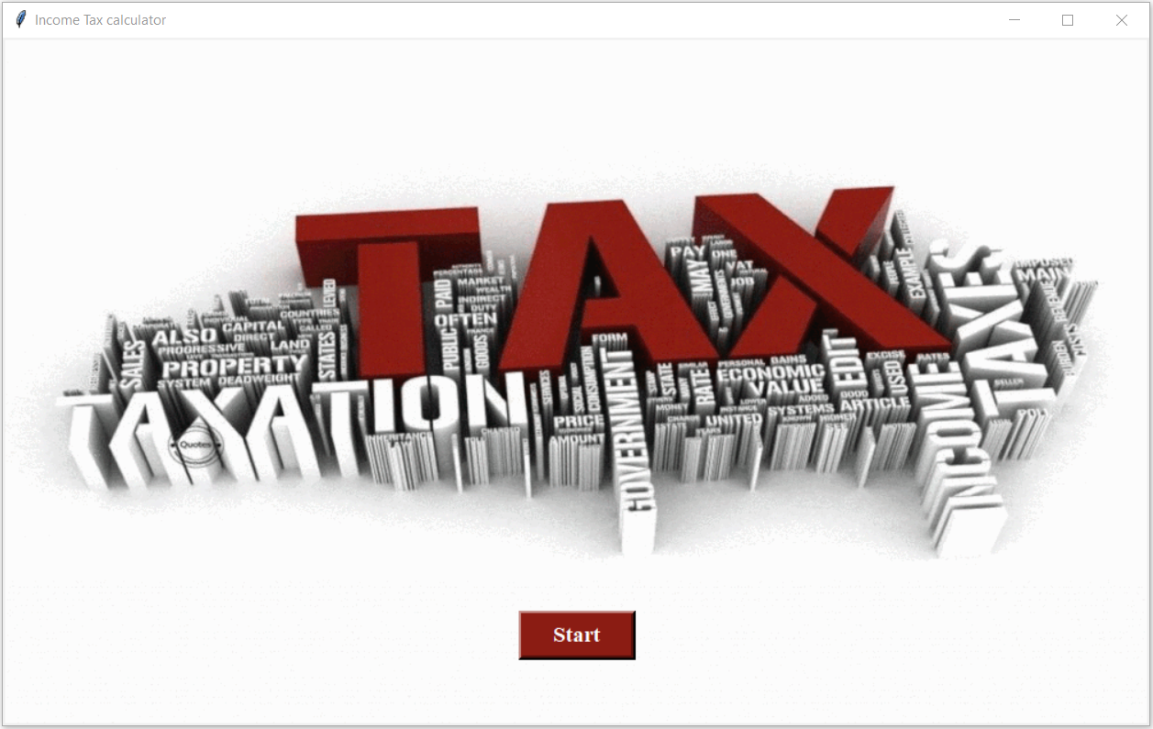
Practical output (front page)
At first users need to click on the start button to proceed .

Slide 11
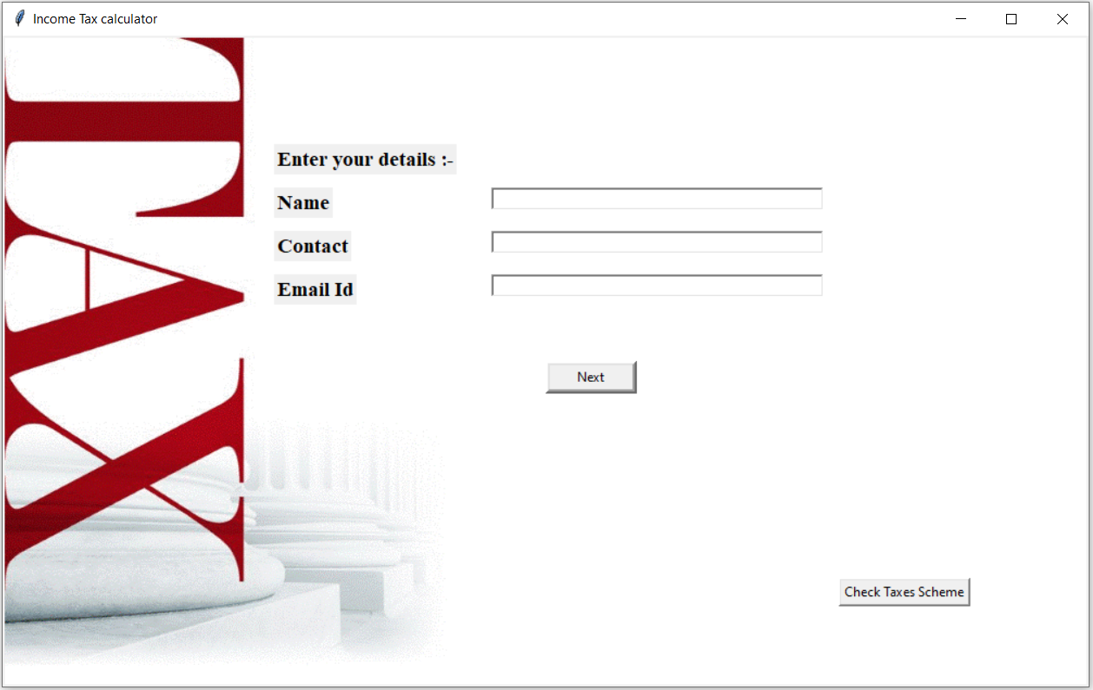
Practical output (page-2)
Then users needs to enter their details like name, contact no. And email id for record purposes.

Slide 12
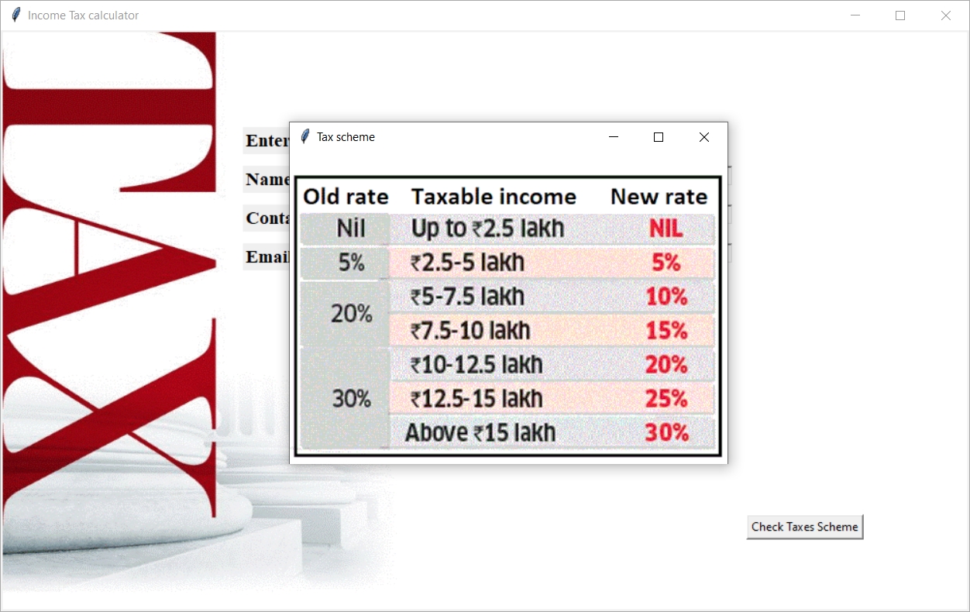
Practical output (page-2)
Users can always check current tax slabs rates by clicking on a button in the bottom right corner (check taxes scheme).

Slide 13

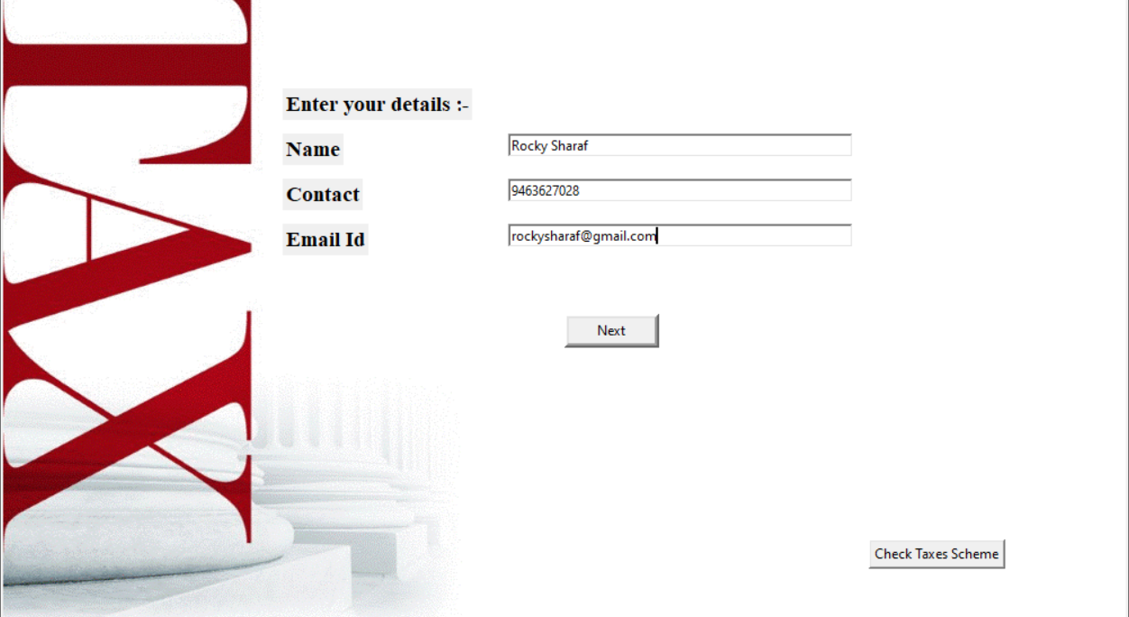
After clicking ‘Next’ user will enter next main page

Slide 14
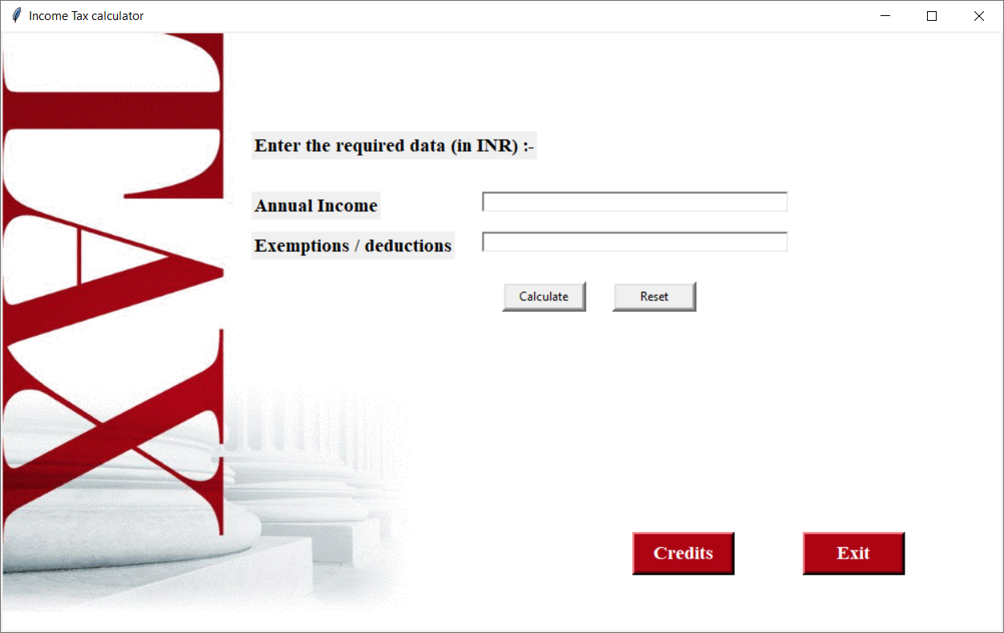
Practical output (page-2)
Users now need to enter their total annual income (sum of salaries, profits, capital gains etc.) For the current assessment year .
Then users need to enter the sum of all deductions (pensions, education loan , medical insurance etc.).
After providing the above inputs users need to click on the calculate button and the output will be displayed.

Slide 15
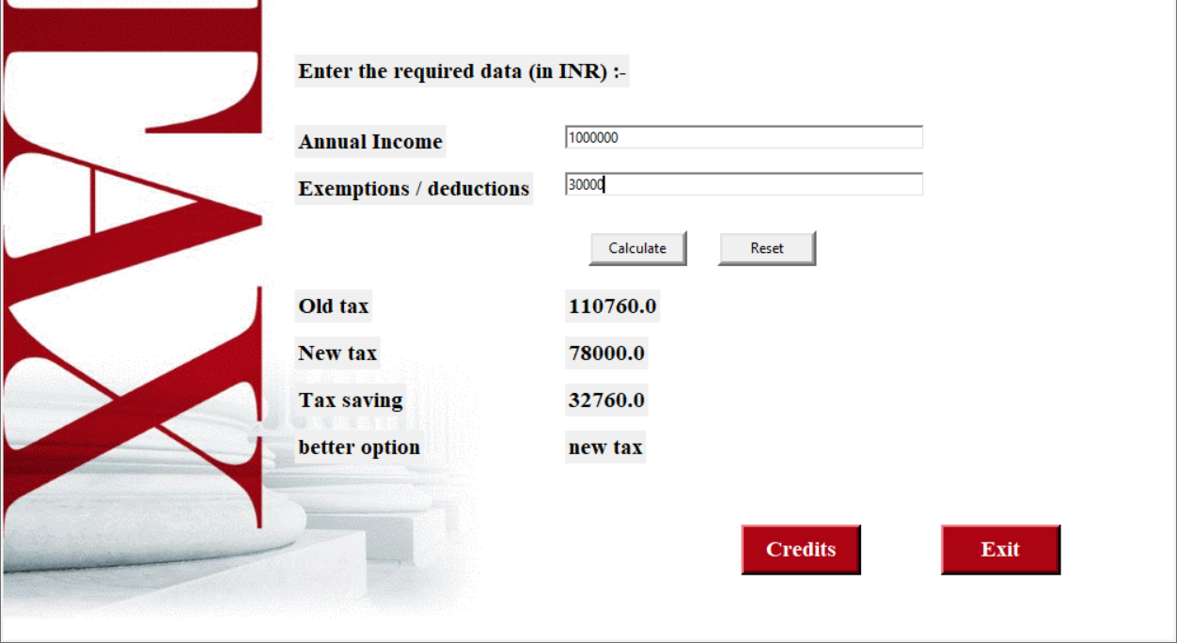
New Tax (As Per Scheme)

Slide 16

Old Tax (As Per Scheme)

Slide 17
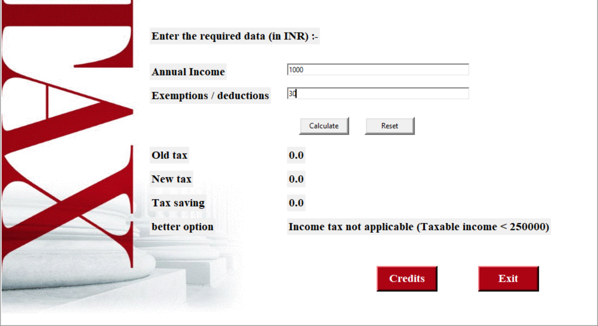
Income Tax not Applicable (as per scheme 2020-21)

Slide 18
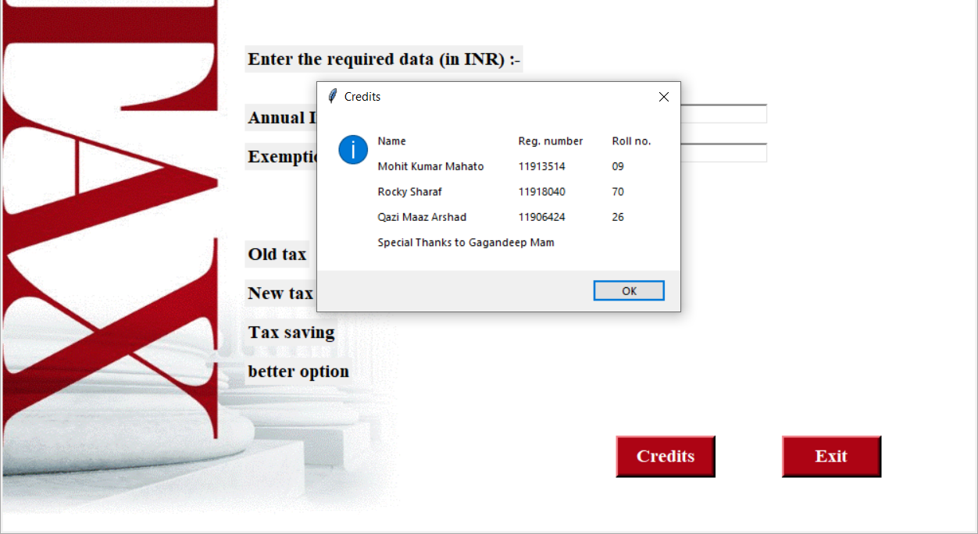
Credit-button

Slide 19
BIBLIOGRAPHY
docs.python.org
www.google.com
www.youtube.com
Book:- Python GUI Programming COOKBOOK - Burkhad A. Meier
Class Notes and Video Lecture – Ms. Gagandeep Kaur

